Slide 1





Conditional Generation of Bass Guitar Tablature for Guitar Accompaniment in Western Popular Music
Data Science Master 2
Research project
Olivier Anoufa
March 2025
Supervisors:
Alexandre D’Hooge
Ken Déguernel

Slide 2
Table of contents
01
05
02
06
03
07
04
Introduction
Conclusion and perspectives
Data processing
Annex
Generative models
Bibliography
Results and discussion

Slide 3
01
Introduction

Slide 4
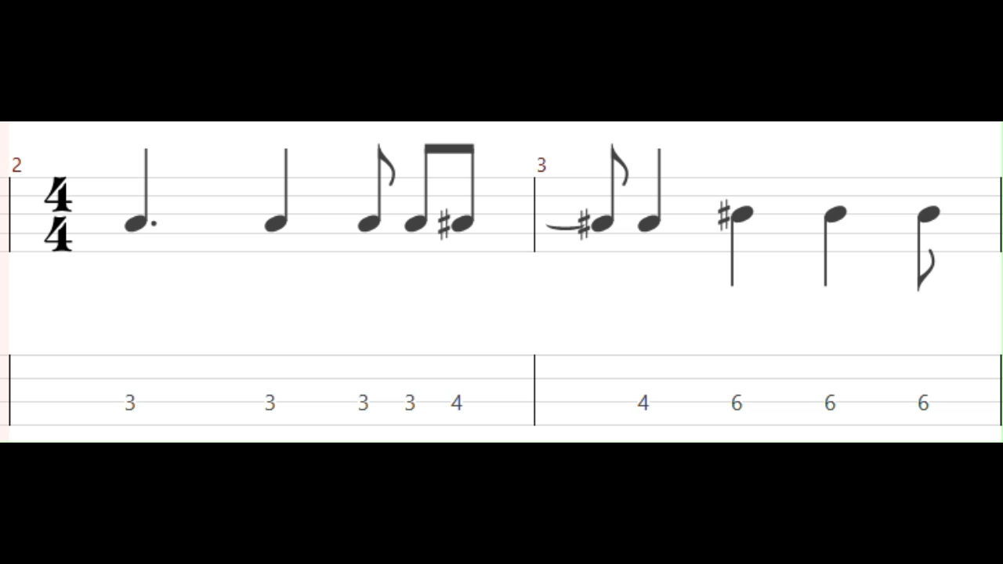
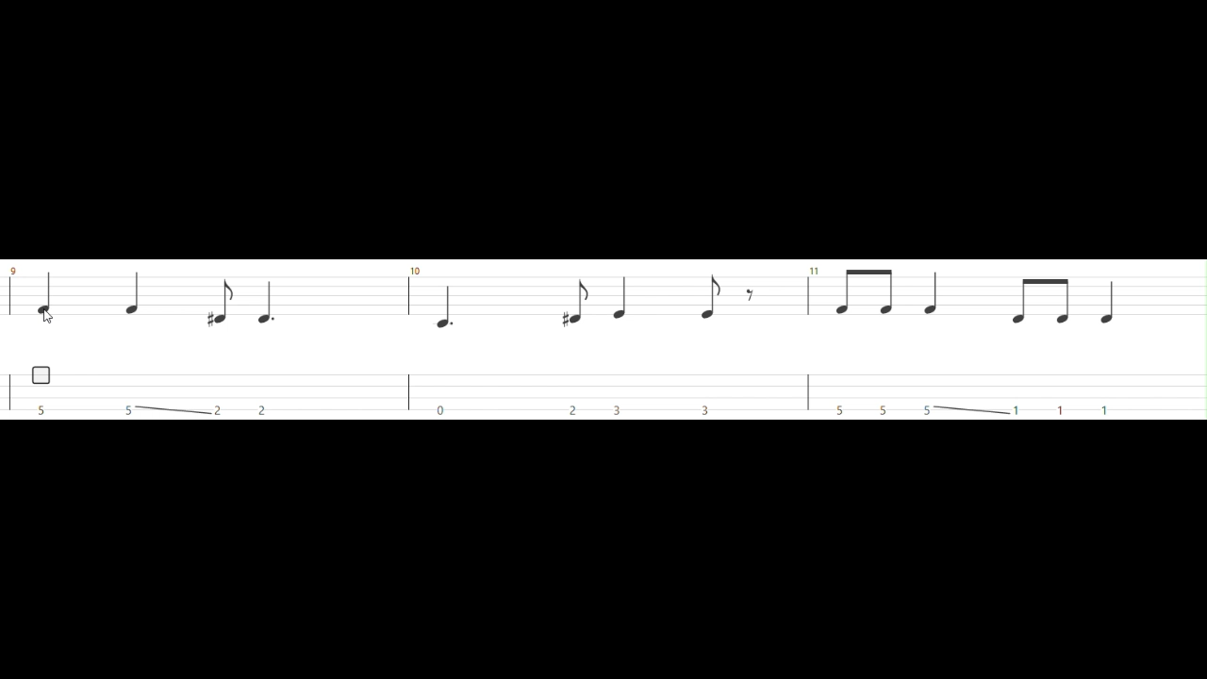
Bass guitar in Western popular music
User study conducted by Bacot et al.¹ on 31 guitarist-composers showed a potential need for accompaniment generation tools for guitarists.
Bass guitar can have a harmonic, rhythmic and sometimes melodic role
Tablatures: simplified and prescriptive notation system
Figure 1: Excerpt of Everything in its Right Place by Radiohead.
Figure 2: Excerpt of Karma Police by Radiohead.

Slide 5
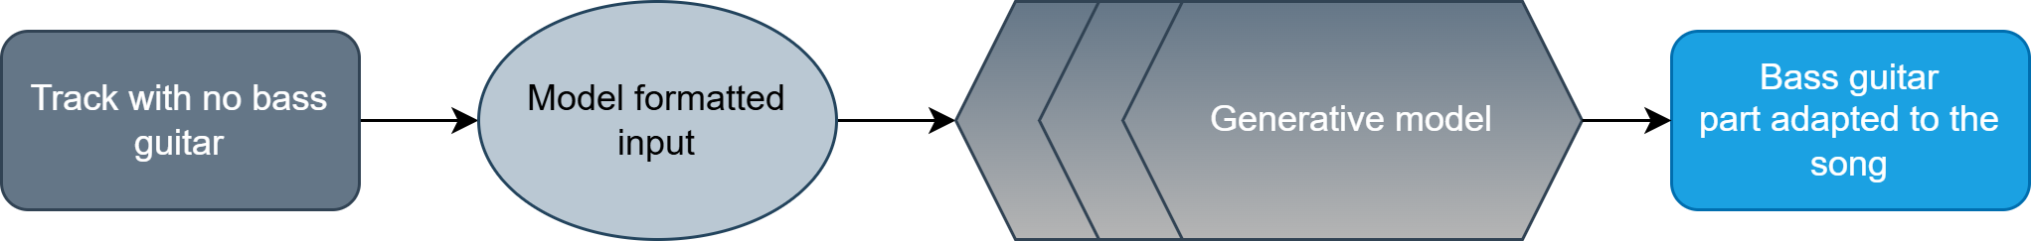
Our vision
The different sections of the pipeline will be detailed in the further sections
Figure 3: Pipeline of the projet

Slide 6
02
Data processing

Slide 7
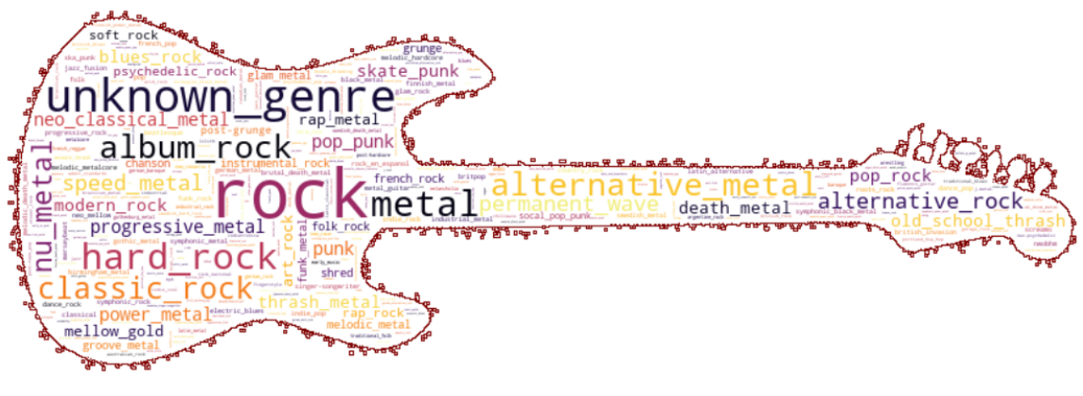
Dataset: DadaGP
26 181 song scores covering 739 musical genres¹
GuitarPro format and tokenized format
Encoder gp_to_tokens and decoder tokens_to_gp
Figure 4: Word cloud representation of the musical genres in DadaGP, taken from¹

Slide 8
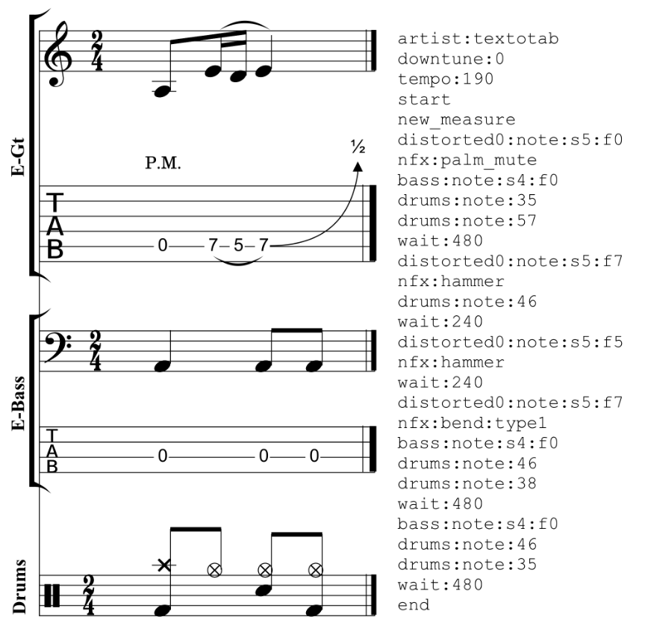
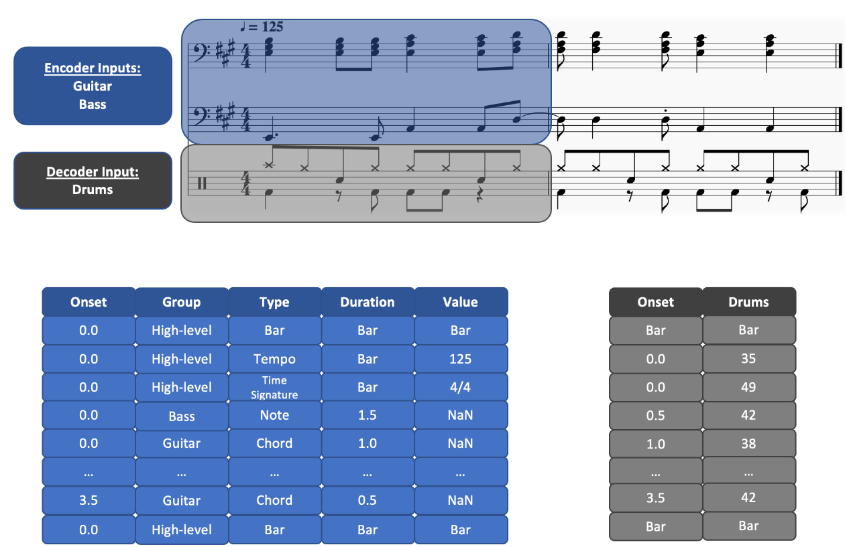
State of the art tokenization models
Figure 5: DadaGP event-based tokenization, taken from¹
Figure 6: Compound word representation, taken from¹

Slide 9
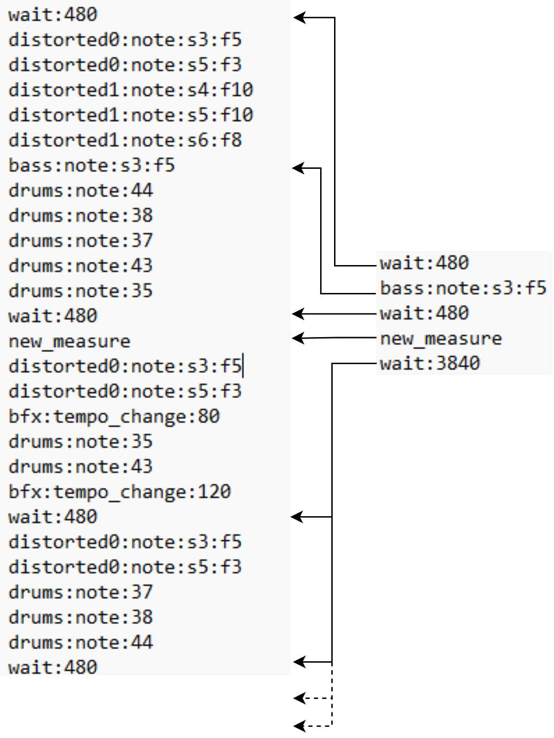
Token extraction
Generation of a dataset of bass guitar token text files
Extraction of the tokens of the wanted instrument
Concatenation of the wait tokens
Figure 7: Example of an extraction of bass guitar tokens in The Strokes - Last Nite

Slide 10
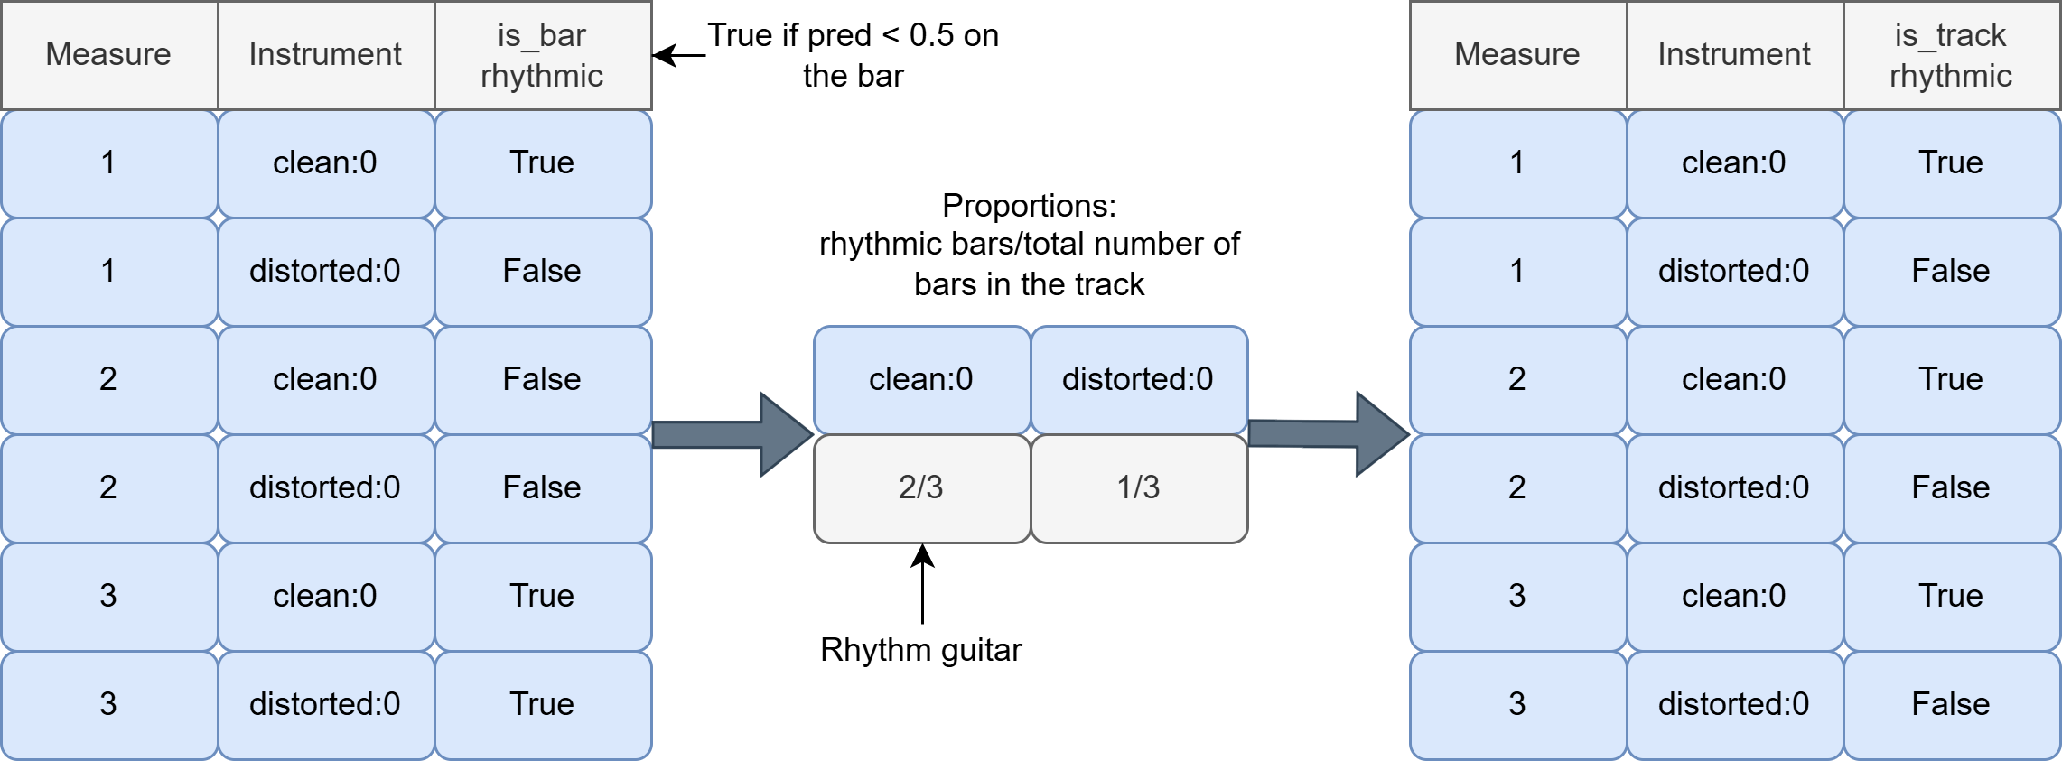
Rhythm guitar identification
Algorithm by Régnier et al.
Figure 8: Example of rhythm guitar selection after applying the method of Régnier et al.¹

Slide 11
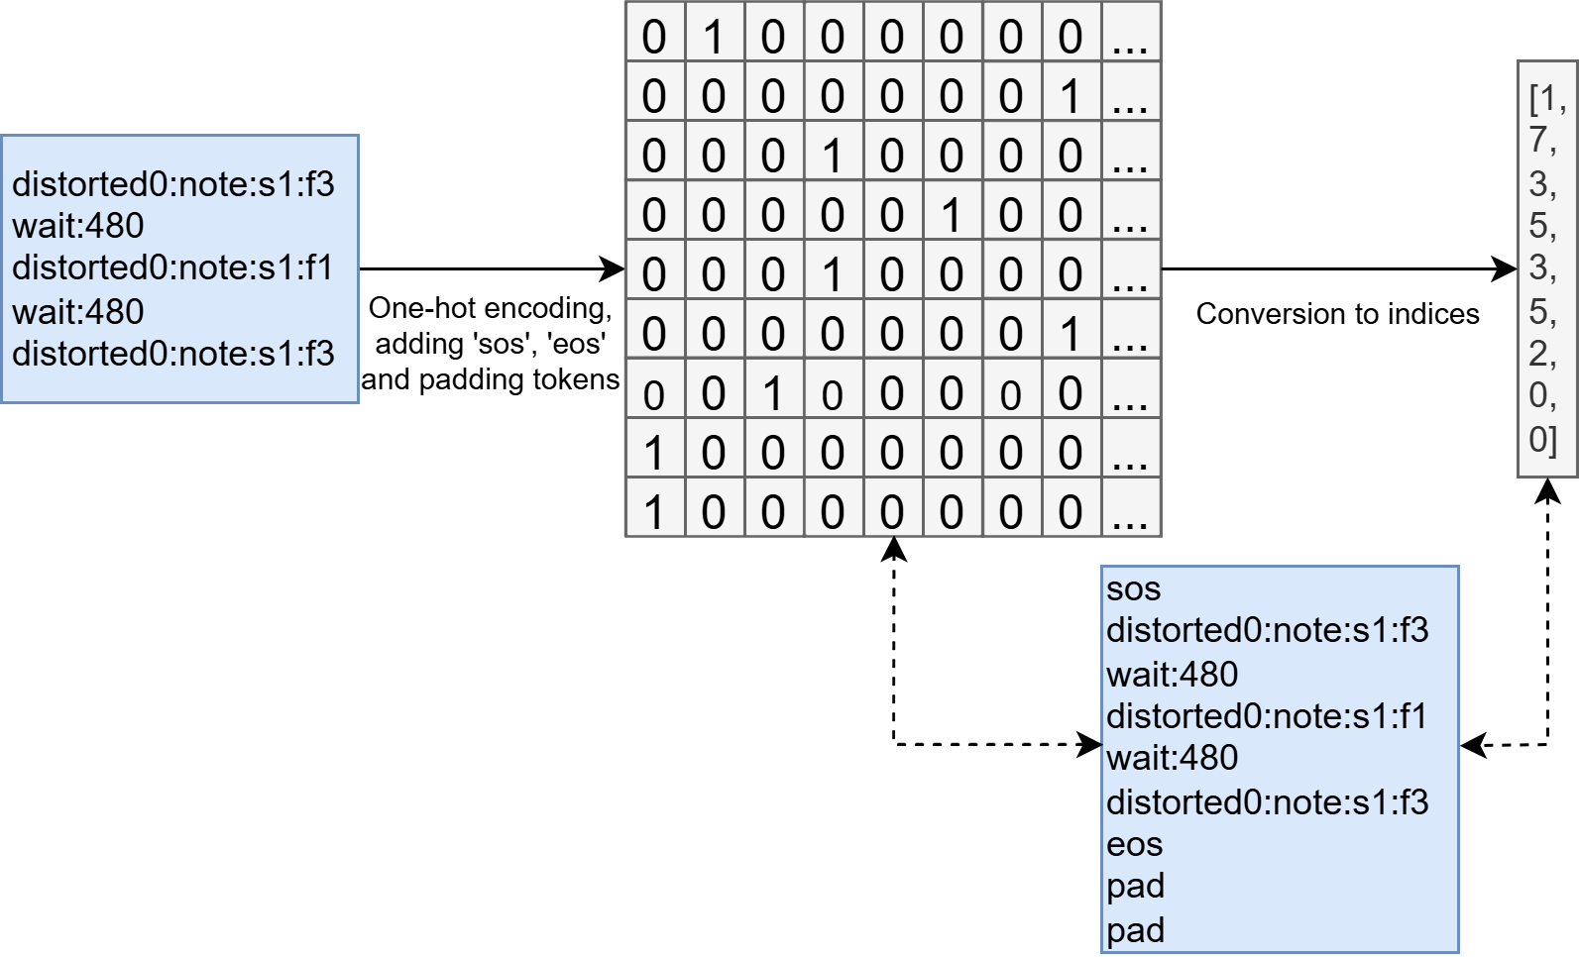
Fitting the data to the model’s input
Conversion to sequences of indices
Sequences padded to 793 tokens for the rhythm guitar and 773 tokens for the bass
Figure X: Conversion from a text token sequence to indices

Slide 12
03
Generative models

Slide 13
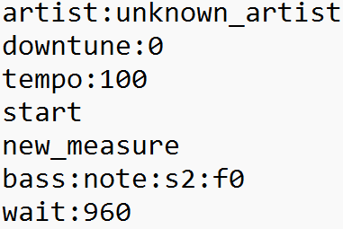
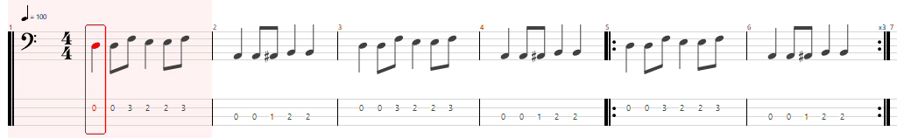
Baseline model
DadaGP checkpoint¹
Repetitive patterns, emergence of other instruments, lack of adaptability (free generation)
Conditional generation based on a prompt only
Figure 9: Example prompt and the corresponding generated bass guitar part

Slide 14
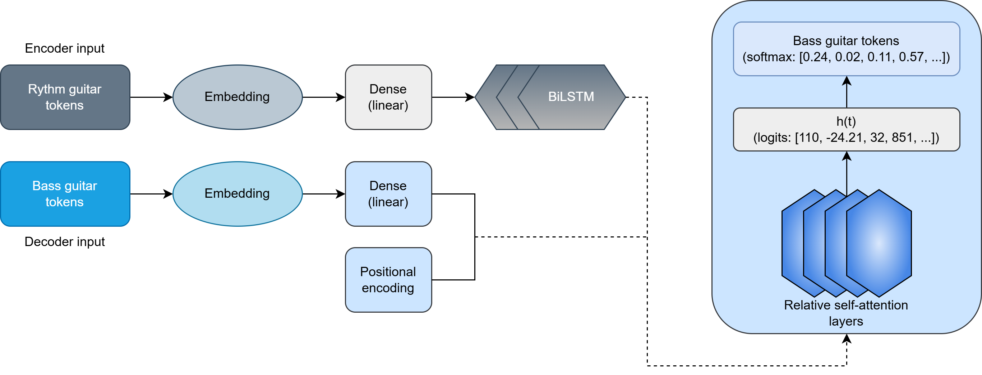
Our model
Adapted from Makris et al.¹
Figure 10: Detailed pipeline of the model

Slide 15
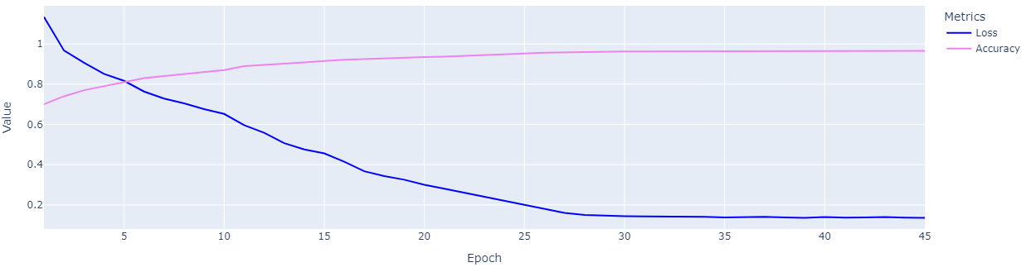
Training
Training done on GPU on Mésocentre de Calcul Scientifique Intensif de l’Université de Lille
Model reached 0.97 accuracy and 0.14 categorical cross-entropy loss on the validation set
Figure 11: Evolution of the accuracy and loss on the validation set

Slide 16
04
Results

Slide 17
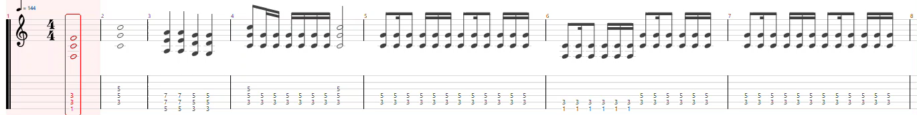
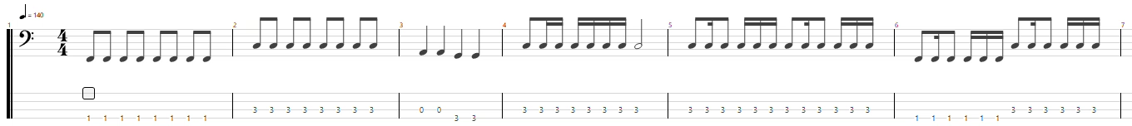
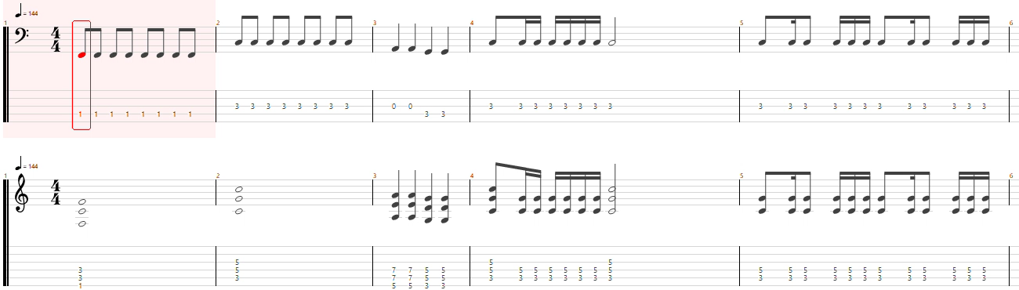
Generated samples
Example 1:
Ultra Vomit – Ricard Peinard
Genre:
Metal
Instrumentation:
Vocals, lead guitar, rhythm guitar, bass and drums
Figure 12: Excerpts of the rhythm guitar, generated bass guitar and combination of both

Slide 18
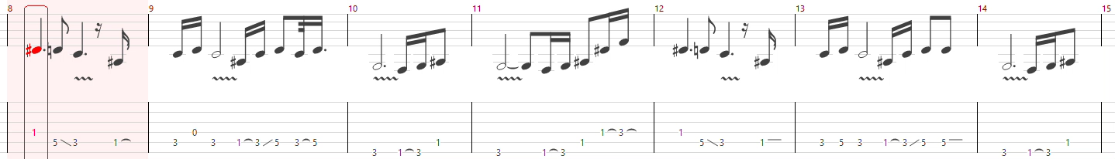
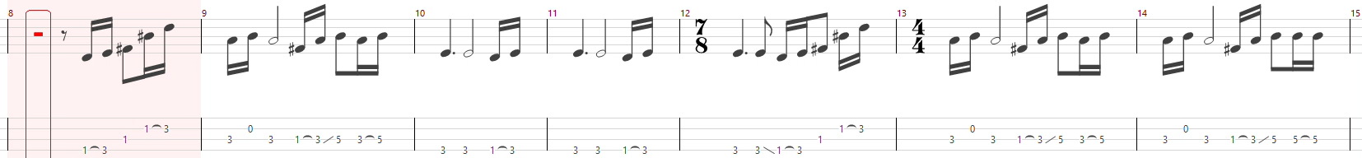
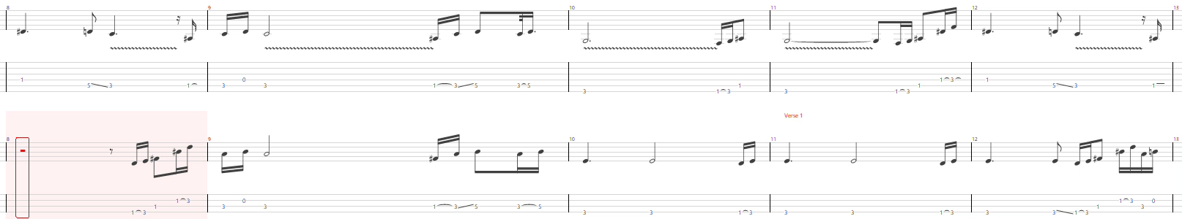
Generated samples
Example 2:
Arctic Monkeys – Do I Wanna Know
Genre:
Indie Rock
Instrumentation:
Vocals, lead guitar, rhythm guitar, bass and drums
Figure 13: Excerpts of the rhythm guitar, generated bass guitar and the combination of both

Slide 19
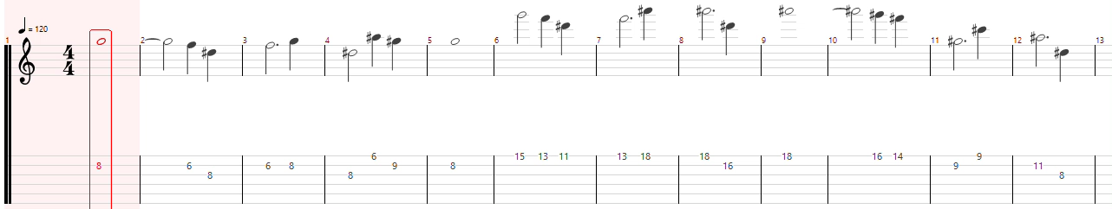
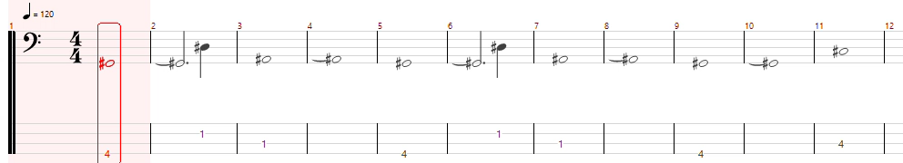
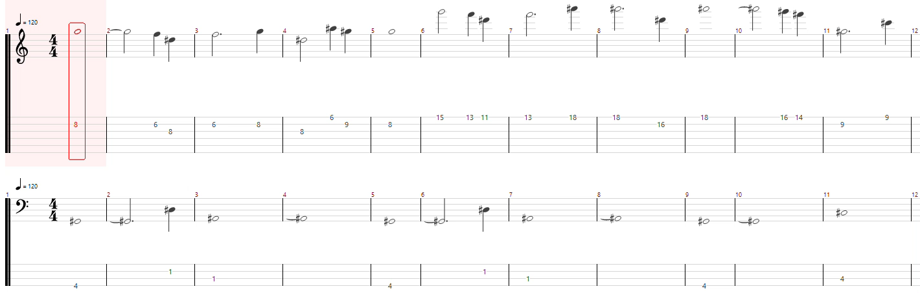
Generated samples
Example 3:
Herbie Hancock – Saturday Night
Genre:
Jazz Funk
Instrumentation:
Vocals, guitar, bass, drums
Figure 14: Excerpts of the rhythm guitar, generated bass guitar and the combination of both

Slide 20
05
Conclusion and perspectives

Slide 21
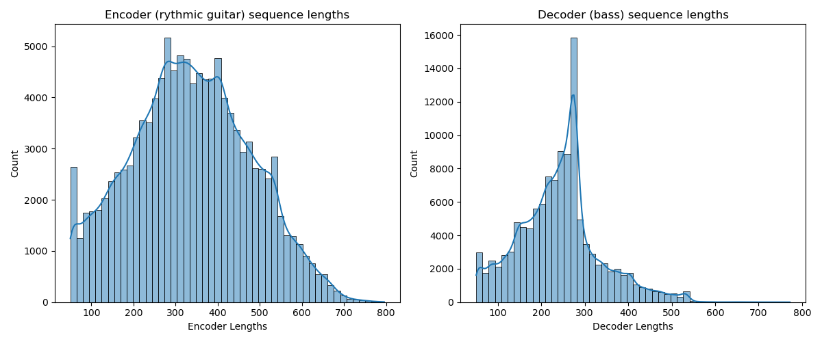



Alternative resources
Figure 15: Distribution of sequence lengths in the training dataset

Slide 22
06
Bibliography

Slide 23
References
Baptiste Bacot, Louis Bigo, and Benoît Navarret. “Tablature software and popular music composition: a user study and perspectives on creative algorithmic tools”. 2025.
Pedro Sarmento, Adarsh Kumar, CJ Carr, Zack Zukowski, Mathieu Barthet, and Yi-Hsuan Yang. “DadaGP: a Dataset of Tokenized GuitarPro Songs for Sequence Models”. In: Proceedings of the 22nd International Society for Music Information Retrieval Conference. 2021.
Dimos Makris, Guo Zixun, Maximos Kaliakatsos-Papakostas, and Dorien Herremans. “Conditional Drums Generation Using Compound Word Representations”. In: Artificial Intelligence in Music, Sound, Art and Design. Cham, 2022.
David Régnier, Nicolas Martin, and Louis Bigo. “Identification of rhythm guitar sections in symbolic tablatures”. In: International Society for Music Information Retrieval Conference (ISMIR). 2021.

